Slide 1
Econ 7900
Statistics for Data Science
Instructor: CAO Kang Hua 曹康華
Lecture 6
The Nature of Economic Data
Analyzing the Association Between Quantitative Variables: Regression Analysis

Slide 2
The Nature of Economic Data
Econometrics = use of statistical methods to analyze economic data
Econometricians typically analyze nonexperimental data
Typical goals of econometric analysis
  Estimating relationships between economic variables
  Testing economic theories and hypotheses
  Forecasting economic variables
  Evaluating and implementing government and business policy

Slide 3
Steps in Econometric Analysis
Steps in econometric analysis
  1) Economic model (this step is often skipped)
  2) Econometric model
Economic models
  Maybe micro- or macromodels
  Often use optimizing behaviour, equilibrium modeling, …
  Establish relationships between economic variables
  Examples: demand equations, pricing equations, …

Slide 4
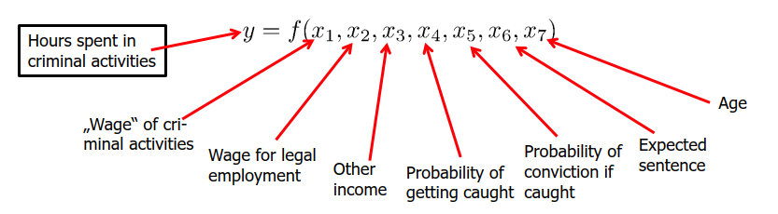
Economic model Example 1
Economic model of crime (Becker (1968))
  Derives equation for criminal activity based on utility maximization
  Functional form of relationship not specified
  Equation could have been postulated without economic modeling

Slide 5
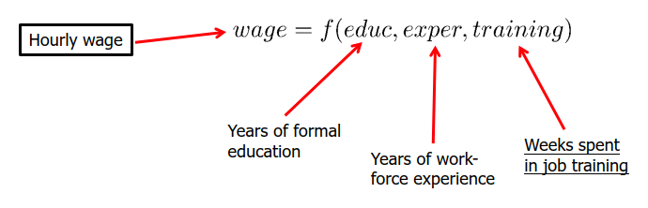
Economic model Example 2
Model of job training and worker productivity
  What is effect of additional training on worker productivity?
  Formal economic theory not really needed to derive equation:
  Other factors may be relevant, but these are the most important (?)

Slide 6
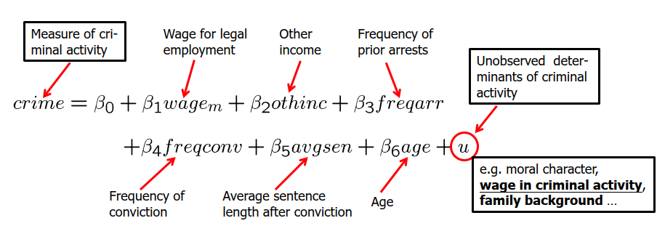
Econometric model Example 1
Econometric model of criminal activity
  The functional form has to be specified
  Variables may have to be approximated by other quantities

Slide 7
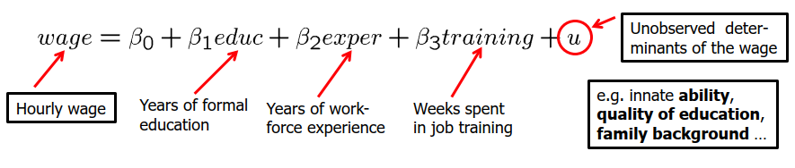
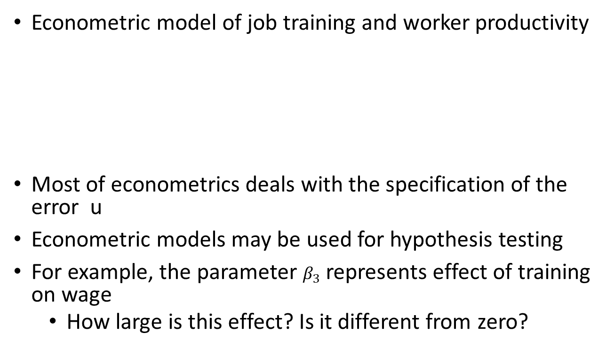
Econometric model Example 2
Econometric model of job training and worker productivity
Most of econometrics deals with the specification of the error u
Econometric models may be used for hypothesis testing
For example, the parameter $β_{3}$ represents effect of training on wage
  How large is this effect? Is it different from zero?

Slide 8
Economic Data
Econometric analysis requires data
Different kinds of economic data sets
  Cross-sectional data
  Time series data
  Pooled cross sections
  Panel/Longitudinal data
Econometric methods depend on the nature of the data used
  Use of inappropriate methods may lead to misleading results

Slide 9
Cross-sectional Data
Cross-sectional data sets
  Sample of individuals, households, firms, cities, states, countries, or other units of interest at a given point of time/in a given period
  Cross-sectional observations are more or less independent
  For example, pure random sampling from a population
  Sometimes pure random sampling is violated, e.g. units refuse to respond in surveys, or if sampling is characterized by clustering
  Cross-sectional data typically encountered in applied microeconomics

Slide 10
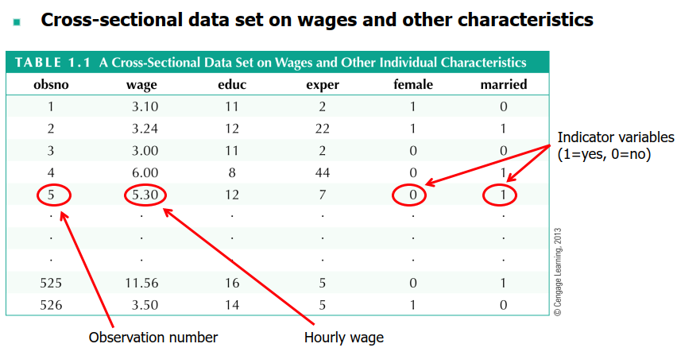
Example of Cross-sectional Data

Slide 11
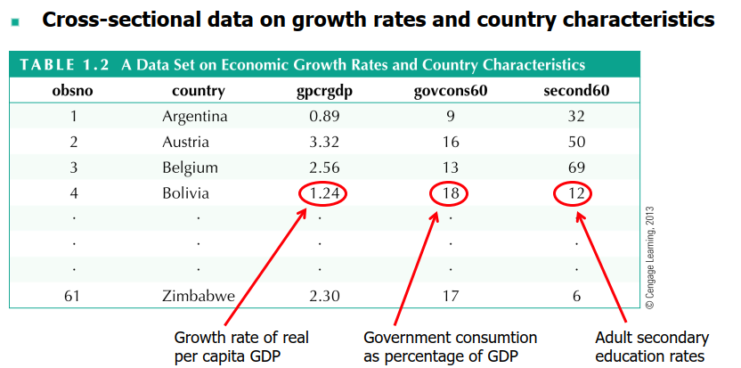
Example of Cross-sectional Data 2

Slide 12
Time Series Data
Time series data
  Observations of a variable or several variables over time
  For example, stock prices, money supply, consumer price index, gross domestic product, annual homicide rates, automobile sales, …
  Time series observations are typically serially correlated
  Ordering of observations conveys important information
  Data frequency: daily, weekly, monthly, quarterly, annually, …
  Typical features of time series: trends and seasonality
  Typical applications: applied macroeconomics and finance

Slide 13
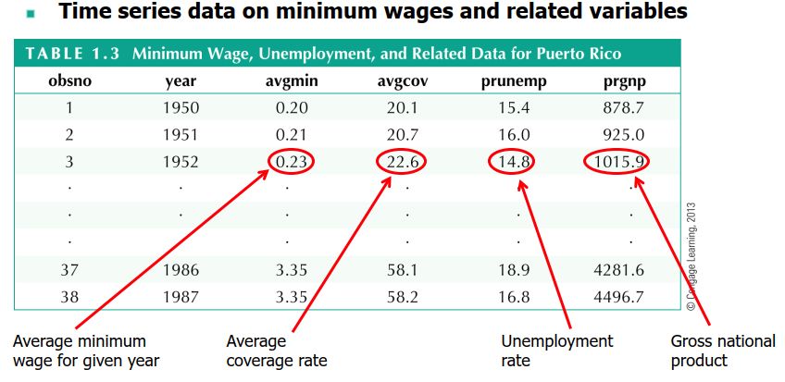
Example of Time Series Data

Slide 14
Pooled Cross Sections Data
Pooled cross sections
  Two or more cross sections are combined in one data set
  Cross sections are drawn independently of each other
  Pooled cross sections often used to evaluate policy changes
  Example:
    Evaluate effect of change in property taxes on house prices
    Random sample of house prices for the year 1993
    A new random sample of house prices for the year 1995
    Compare before/after (1993: before reform, 1995: after reform)

Slide 15
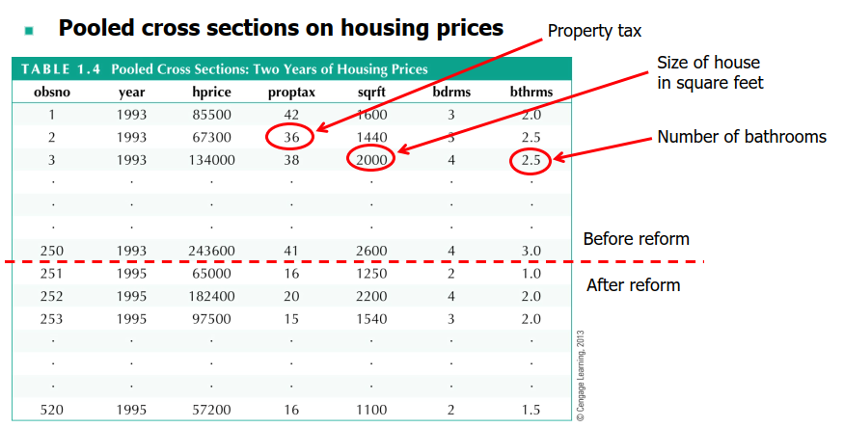
Example of Pooled Cross Sections
Data

Slide 16
Panel Data
Panel or longitudinal data
  The same cross-sectional units are followed over time
  Panel data have a cross-sectional and a time series dimension
  Panel data can be used to account for time-invariant unobservables
  Panel data can be used to model lagged responses
  Example:
    City crime statistics; each city is observed in two years
    Time-invariant unobserved city characteristics may be modeled
    Effect of police on crime rates may exhibit time lag

Slide 17
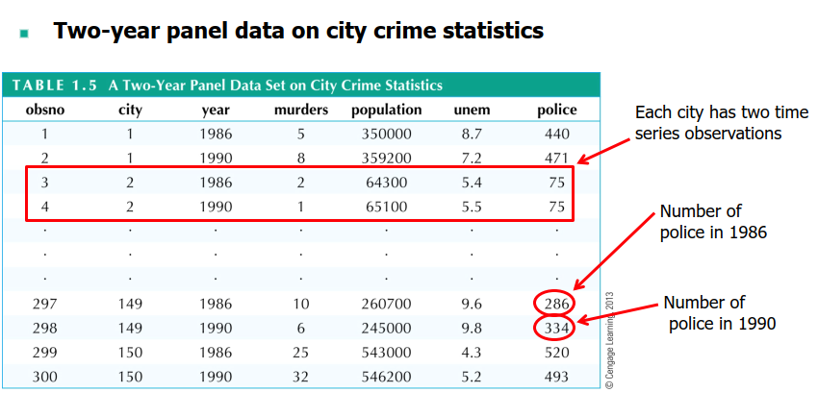
Example of Panel Data

Slide 18
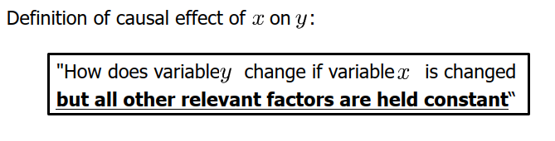
Causality and Ceteris Paribus
Causality and the notion of ceteris paribus
Most economic questions are ceteris paribus questions
It is important to define which causal effect one is interested in
It is useful to describe how an experiment would have to be designed to infer the causal effect in question

Slide 19
Example of Causality 1
Causal effect of fertilizer on crop yield
  "By how much will the production of soybeans increase if one increases the amount of fertilizer applied to the ground"
  Implicit assumption: all other factors that influence crop yield such as quality of land, rainfall, presence of parasites etc. are held fixed
Experiment:
  Choose several one-acre plots of land; randomly assign different amounts of fertilizer to the different plots; compare yields
  Experiment works because amount of fertilizer applied is unrelated to other factors influencing crop yields

Slide 20
Example of Causality 2
Measuring the return to education
  "If a person is chosen from the population and given another year of education, by how much will his or her wage increase? "
  Implicit assumption: all other factors that influence wages such as experience, family background, intelligence etc. are held fixed
Experiment:
  Choose a group of people; randomly assign different amounts of education to them (infeasible!); compare wage outcomes
  Problem without random assignment: amount of education is related to other factors that influence wages (e.g.，intelligence)

Slide 21
Example of Causality 3
Effect of law enforcement on city crime level
  "If a city is randomly chosen and given ten additional police officers, by how much would its crime rate fall? "
  Alternatively: "If two cities are the same in all respects, except that city A has ten more police officers, by how much would the two cities crime rates differ? "
Experiment:
  Randomly assign number of police officers to a large number of cities
  In reality, number of police officers will be determined by crime rate (simultaneous determination of crime and number of police)

Slide 22
Group Project (20%)
Form a team with 3 members; sign up in the link from Moodle.
Each team will develop a statistical project that answers a research question using statistical techniques.
The focus of this project is to collect data from various sources and construct the final data set that are suitable for further analysis.
The team will first make a ~15-minute classroom presentation during the last two lectures (individual 10%) and then submit the presentation slides as a summary report (team 10%).
Peer Evaluation Form in Moodle (1%)

Slide 23
Group Project (20%)
Practice your skills in handling data sets
Combine differences sources into one dataset
See the data collection exercise as an example.
No need to perform statistical analysis (i.e., running regressions)

Slide 24
Grading – Individual Presentation Skills (10%)
Did the speaker talk loudly and clearly enough to be understood?
Did the speaker use appropriate scientific language?
Was correct grammar used in the oral presentation?
Did the speaker use eye contact, gestures, and voice inflections to maintain the audience?
Was the speaker able to present the material without excessive dependence on notes?
Did the speaker stay within the time limit?
Did the speaker appear to understand the material?
Peer evaluation

Slide 25
Grading – Team Presentation Content (team 10%)
Did the introduction provide sufficient background for the audience to understand the topic?
Did the presentation enhance the audience’s understanding of the topic?
Was the subject matter developed in a logical order?
Given the time constraints, was the topic developed sufficiently?
Did the summary or conclusion emphasize the significance of the information?
Were the visual aids easily read and appropriate for the information presented?
Were the participants’ questions answered satisfactorily?

Slide 26
What should you include in the final report?
The research question that you are interested in answering.
Background information
The statistical methods and techniques that will be used to analyze the data
Data source and collection process
Justification for using specific data and method in relation to the research question.

Slide 27
Past email conversation with the students
Q: Would this topic […] be appropriate?
Answer: A complete topic is not one or two sentences like the answer to what is your hobby. It will include the full plan to carry out the research. Think about these questions:
What is your research question? The topic needs to begin with a question.
What are the potential answers and what are the evidence and arguments to justify your answers.
This is a data quantitative project, so you need data to support the answers. Simply speaking, what is your y variable and what are the x variables? Are the all data available?

Slide 28
Past email conversation with the students
Comments from a student:
“I think we cannot conclude whether or not some thing is related to others before we carry out a research.”
“This assumption may be true or false, I can only tell by putting the figures into a model and determine by the resulting p-value.”
What do you think?

Slide 29
What is a scientific method?
From Wiki
“The process of the scientific method involves making conjectures (hypotheses), deriving predictions from them as logical consequences, and then carrying out experiments or empirical observations based on those predictions”
If we ignore the thinking process, we may just identify a spurious correlation.
“Essentially, all models are wrong, but some are useful“ by George Box

Slide 30
Modeling How Two Variables Are Related

Slide 31
Regression Analysis
The first step of a regression analysis is to identify the response and explanatory variables.
  We use y to denote the response variable.
  We use x to denote the explanatory variable.

Slide 32
The Scatterplot
The first step in answering the question of association is to look at the data.
  A scatterplot is a graphical display of the relationship between the response variable (y) and the explanatory variable (x).

Slide 33
Example: The Strength Study
An experiment was designed to measure the strength of female athletes.
The goal of the experiment was to determine if there is an association between the maximum number of pounds that each individual athlete could bench press and the number of 60-pound bench presses that athlete could do.

Slide 34
Example: The Strength Study
57 high school female athletes participated in the study.
The data consisted of the following variables:
  x: the number of 60-pound bench presses an athlete could do.
  y: maximum bench press.

Slide 35
Example: The Strength Study
For the 57 females in this study, these variables are
summarized by:
  x: mean = 11.0, standard deviation = 7.1.
  y: mean = 79.9 lbs, standard deviation = 13.3 lbs.

Slide 36
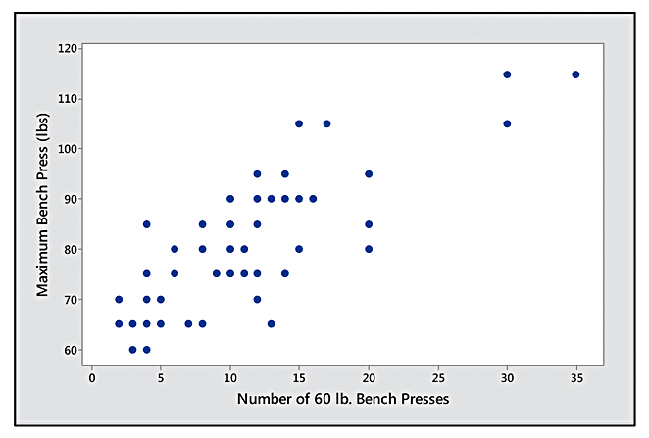
Example: The Strength Study
Figure 12.1 Scatterplot for y = Maximum Bench Press and x = Number of 60-lb. Bench Presses

Slide 37
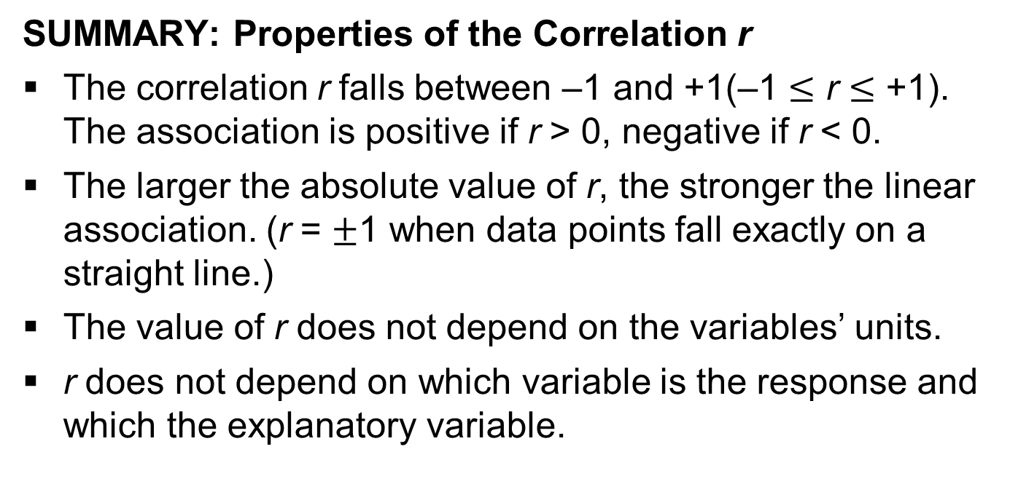
Describing the Association in the Scatterplot by the Correlation
SUMMARY: Properties of the Correlation r
The correlation r falls between –1 and +1(–1 $≤$ r $≤$ +1). The association is positive if r > 0, negative if r < 0.
The larger the absolute value of r, the stronger the linear association. (r = $±$1 when data points fall exactly on a straight line.)
The value of r does not depend on the variables’ units.
r does not depend on which variable is the response and which the explanatory variable.

Slide 38
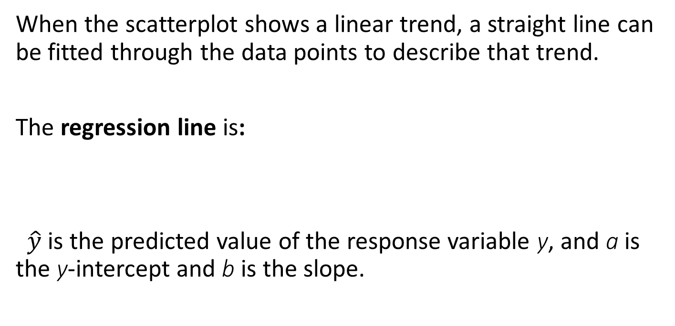
The Regression Line Equation
When the scatterplot shows a linear trend, a straight line can be fitted through the data points to describe that trend.
The regression line is:
$\hat{y}$is the predicted value of the response variable y, and a is the y-intercept and b is the slope.

Slide 39
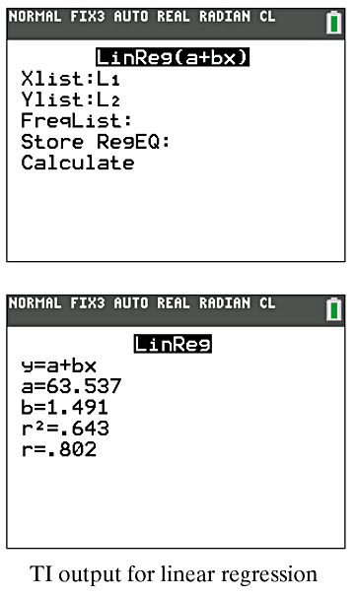
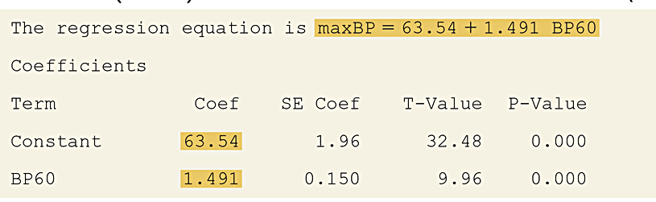
Example: Regression Line Predicting Maximum Bench Press
Table 12.1 MINITAB Printout for Regression Analysis of y = Maximum Bench Press (BP) and x = Number of 60-Pound Bench Presses (BP60)

Slide 40
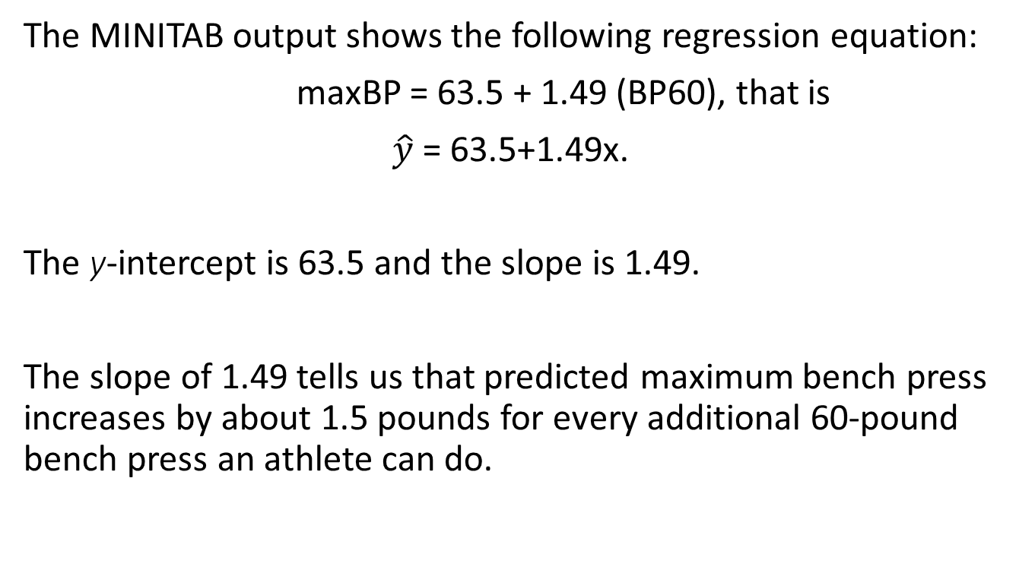
Example: Regression Line Predicting Maximum Bench Press
The MINITAB output shows the following regression equation:
maxBP = 63.5 + 1.49 (BP60), that is
$\hat{y}$= 63.5+1.49x.
The y-intercept is 63.5 and the slope is 1.49.
The slope of 1.49 tells us that predicted maximum bench press increases by about 1.5 pounds for every additional 60-pound bench press an athlete can do.

Slide 41
Outliers
Check for outliers by plotting the data.
The regression line can be pulled toward an outlier and away from the general trend of points.

Slide 42
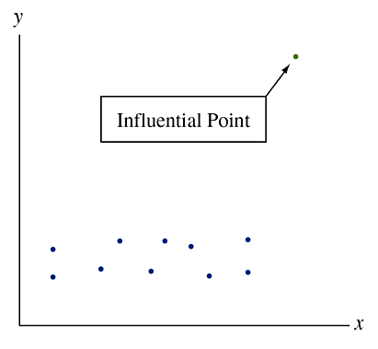
Influential Points
An observation can be influential in affecting the regression line when one or more of two things happen:
  Its x value is low or high compared to the rest of the data.
  It does not fall in the straight-line pattern that the rest of the data have.

Slide 43
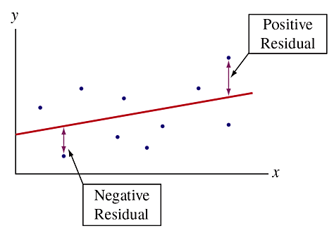
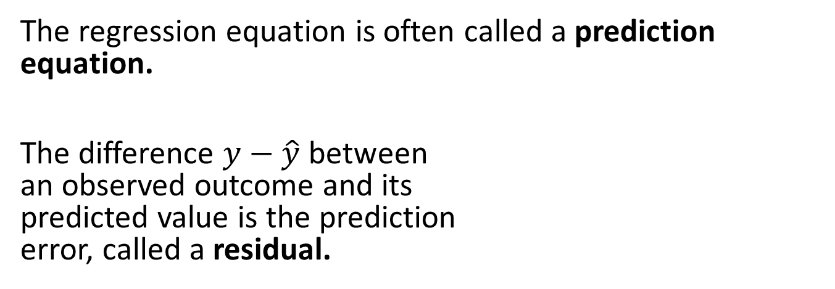
Residuals are Prediction Errors
The regression equation is often called a prediction equation.
The difference $y−\hat{y}$ between
an observed outcome and its
predicted value is the prediction
error, called a residual.

Slide 44
SUMMARY: Review of Residuals
Each observation has a residual.
A residual is the vertical distance between the data point and the regression line.
The smaller the distance, the better the prediction.

Slide 45
SUMMARY: Review of Residuals
We can summarize how close to the regression line the data points fall by
The regression line has the smallest sum of squared residuals and is called the least squares line.

Slide 46
Regression Model: A Line Describes How the Mean of y Depends on x
At a given value of x, the equation:
  Predicts a single value of the response variable.
  But… we should not expect all subjects at that value of x to have the same value of y because variability occurs in the y values.
At a given value of x, the equation:
  Predicts a single value of the response variable.
  But… we should not expect all subjects at that value of x to have the same value of y because variability occurs in the y values.

Slide 47
SUMMARY: The Regression Line
The regression line connects the estimated means of y at the various x values.
In summary, ŷ = a + bx, describes the relationship between x and the estimated means of y at the various values of x.

Slide 48
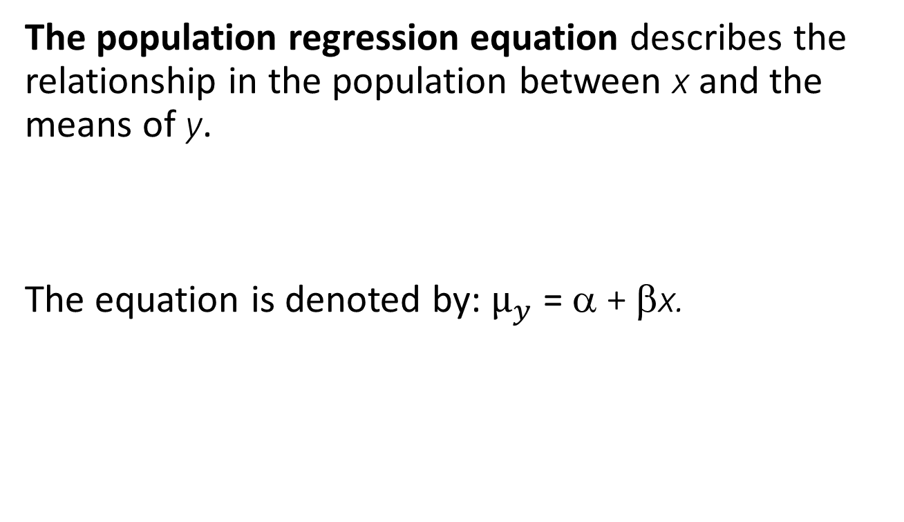
The Population Regression Equation
The population regression equation describes the relationship in the population between x and the means of y.
The equation is denoted by:$μ_{y}$ = α + βx.

Slide 49
The Population Regression Equation
In the population regression equation, α is a population y-intercept and β is a population slope.
  These are parameters, so in practice their values are unknown.
In practice we estimate the population regression equation using the prediction equation for the sample data.

Slide 50
The Population Regression Equation
The population regression equation merely approximates the actual relationship between x and the population means of y. It is a model.
A model is a simple approximation for how variables relate in a population.

Slide 51
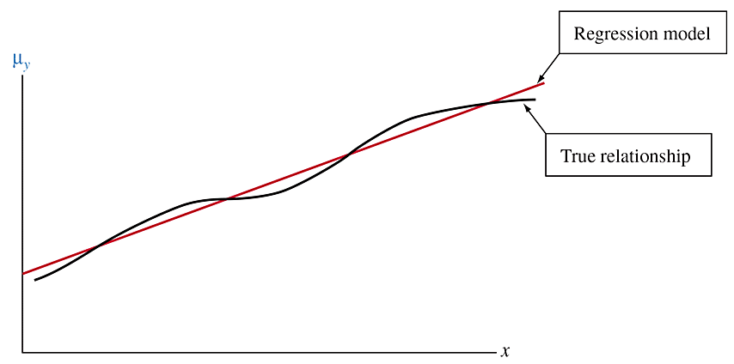
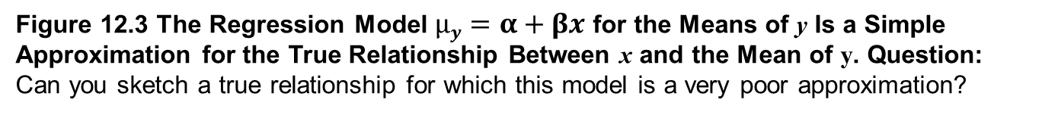
The Regression Model
Figure 12.3 The Regression Model $μy=α+βx$ for the Means of y Is a Simple Approximation for the True Relationship Between x and the Mean of y. Question: Can you sketch a true relationship for which this model is a very poor approximation?

Slide 52
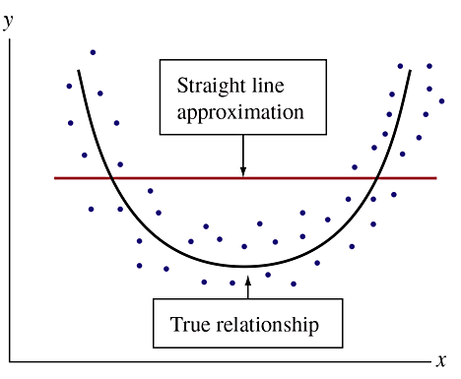
The Regression Model
If the true relationship is far from a straight line, this regression model may be a poor one.
Figure 12.4 The Straight-Line Regression Model Provides a Poor Approximation When the Actual Relationship Is Highly Nonlinear. Question: What type of mathematical function might you consider using for a regression model in this case?

Slide 53
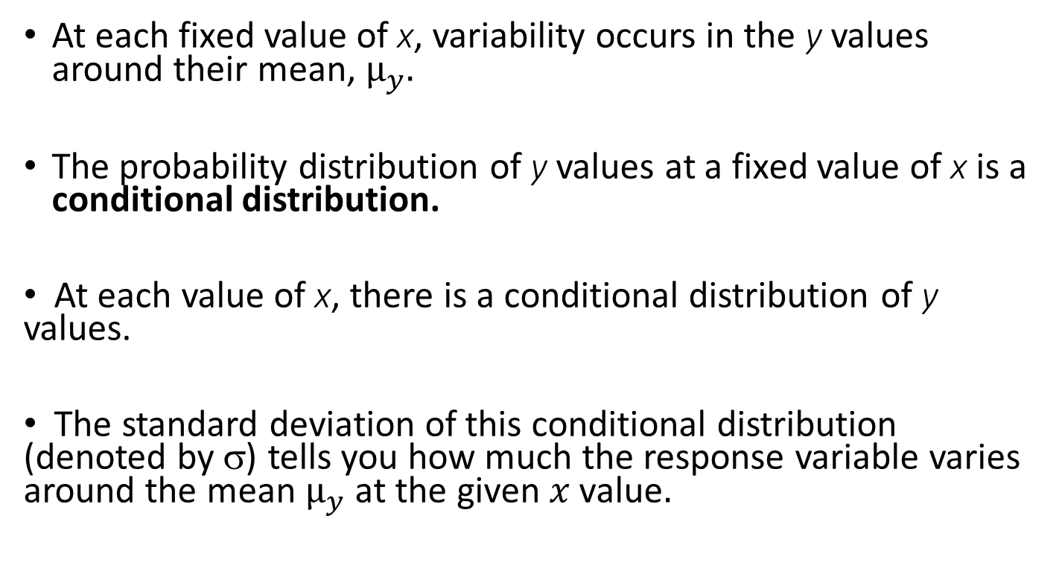
The Regression Model Also Allows Variability About the Line
At each fixed value of x, variability occurs in the y values around their mean, $μ_{y}.$
The probability distribution of y values at a fixed value of x is a conditional distribution.
At each value of x, there is a conditional distribution of y values.
The standard deviation of this conditional distribution (denoted by σ) tells you how much the response variable varies around the mean $μ_{y} \text{at} \text{the} \text{given} x \text{v}\text{alue}.$

Slide 54
A Statistical Model
A statistical model never holds exactly in practice.
It is merely a simple approximation of reality.
Even though it does not describe reality exactly, a model is useful if the true relationship is close to what the model predicts.

Slide 55
Inference About Model Parameters and the Association

Slide 56
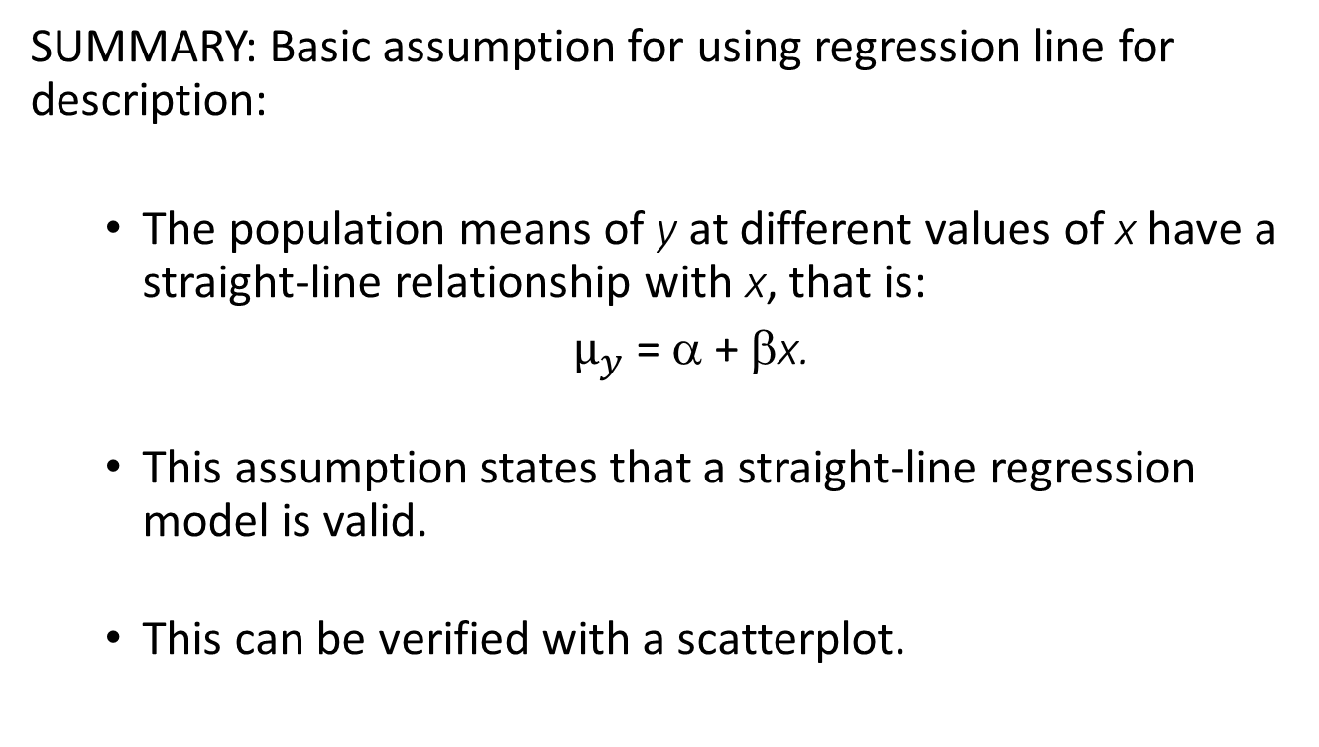
Assumptions for Regression Analysis
SUMMARY: Basic assumption for using regression line for description:
  The population means of y at different values of x have a straight-line relationship with x, that is:
  $μ_{y}$ = α + βx.
  This assumption states that a straight-line regression model is valid.
  This can be verified with a scatterplot.

Slide 57
Assumptions for Regression Analysis
SUMMARY: Extra assumptions for using regression to make statistical inference:
  The data were gathered using randomization, such as random sampling or a randomize experiment.
  The population values of y at each value of x follow a normal distribution, with the same standard deviation (σ) at each x value.

Slide 58
Assumptions for Regression Analysis
Models, such as the regression model, merely approximate the true relationship between the variables.
A relationship will not be exactly linear, with exactly normal distributions for y at each x and with exactly the same standard deviation of y values at each x value.

Slide 59
Testing Independence between Quantitative Variables
Suppose that the slope β of the regression line equals 0
Then…
  The population mean of y is identical at each x value.
  The two variables, x and y, are statistically independent:
  The outcome for y does not depend on the value of x.
  It does not help us to know the value of x if we want to predict the value of y.

Slide 60
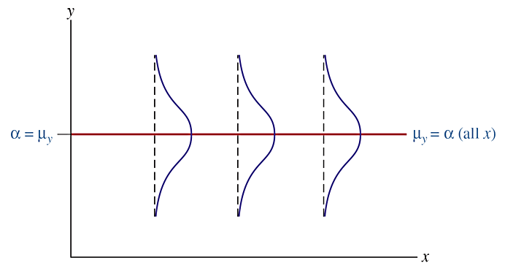
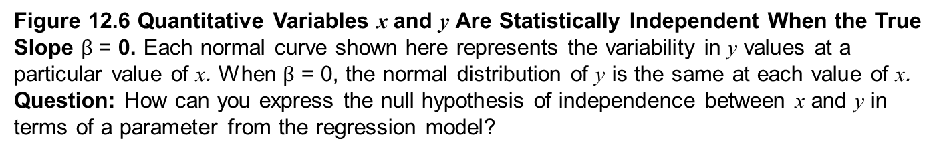
Testing Independence between Quantitative Variables
Figure 12.6 Quantitative Variables x and y Are Statistically Independent When the True Slope $β$ = 0. Each normal curve shown here represents the variability in y values at a
particular value of x. When $β$ = 0, the normal distribution of y is the same at each value of x.
Question: How can you express the null hypothesis of independence between x and y in terms of a parameter from the regression model?

Slide 61
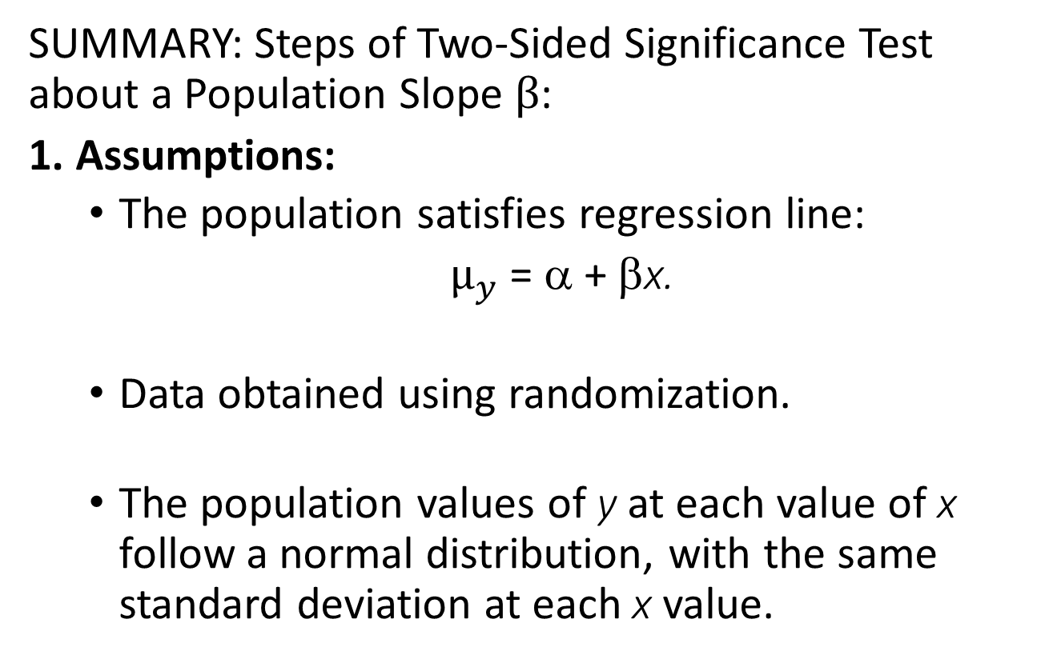
Testing Independence between Quantitative Variables
SUMMARY: Steps of Two-Sided Significance Test about a Population Slope $β$:
1. Assumptions:
  The population satisfies regression line:
  $μ_{y}$ = α + βx.
  Data obtained using randomization.
  The population values of y at each value of x follow a normal distribution, with the same standard deviation at each x value.

Slide 62
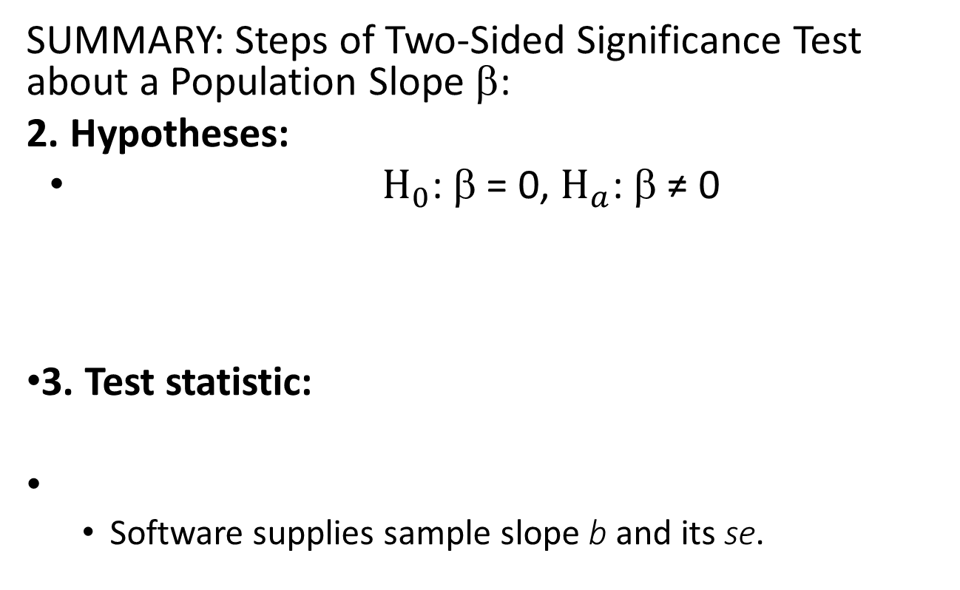
Testing Independence between Quantitative Variables
SUMMARY: Steps of Two-Sided Significance Test about a Population Slope β:
2. Hypotheses:
$H_{0}$: β = 0, $H_{a}$: β ≠ 0
3. Test statistic:
  Software supplies sample slope b and its se.

Slide 63
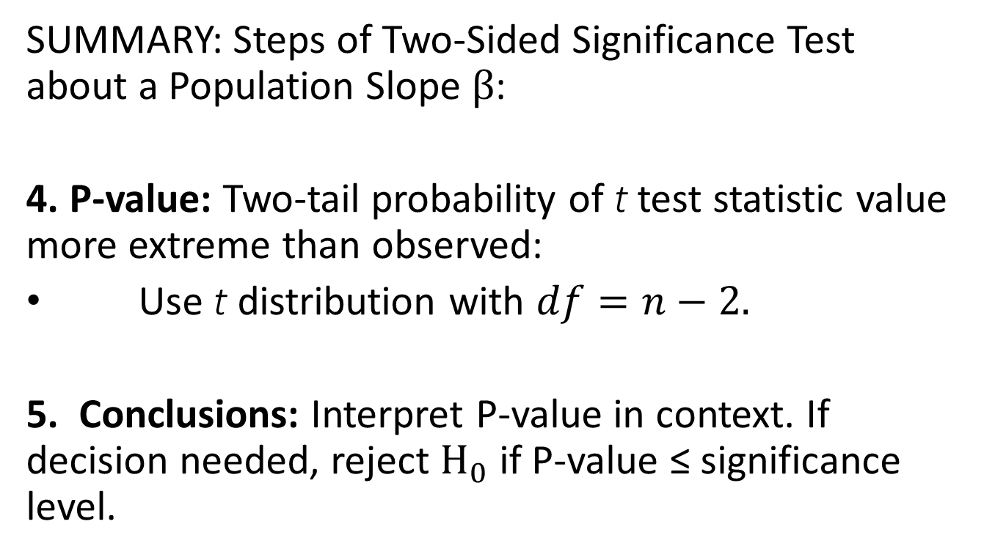
Testing Independence between Quantitative Variables
SUMMARY: Steps of Two-Sided Significance Test about a Population Slope $β$:
4. P-value: Two-tail probability of t test statistic value more extreme than observed:
Use t distribution with $df=n−2.$
5. Conclusions: Interpret P-value in context. If decision needed, reject $H_{0}$ if P-value ≤ significance level.

Slide 64
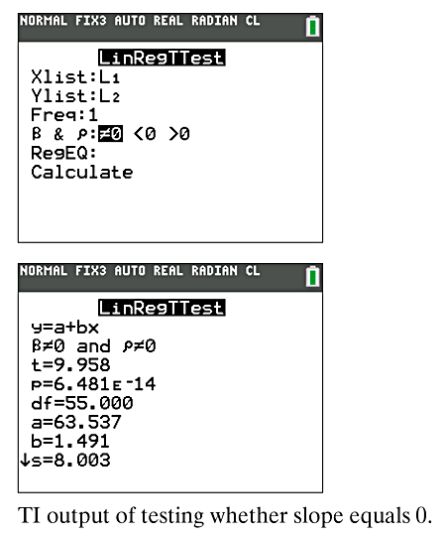
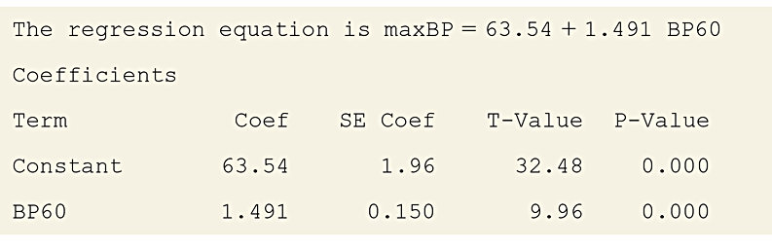
Example: 60-Pound Strength and Bench Presses
Table 12.2 MINITAB Printout for Regression Analysis of y = Maximum Bench Press (maxBP) and x = Number of 60-Pound Bench Presses (BP60).

Slide 65
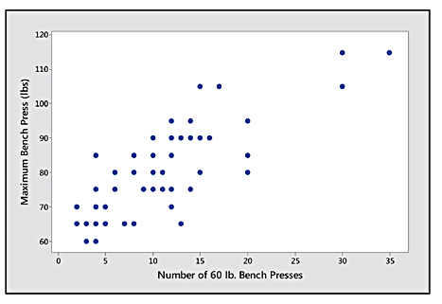
Example: 60-Pound Strength and Bench Presses
Conduct a two-sided significance test of the null hypothesis of independence.
1. Assumptions:
  A scatterplot of the data revealed a linear trend so the straight-line regression model seems appropriate.
  The scatter of points have a similar spread at different x values.
  The sample was a convenience sample, not a random sample, so this is a concern.

Slide 66
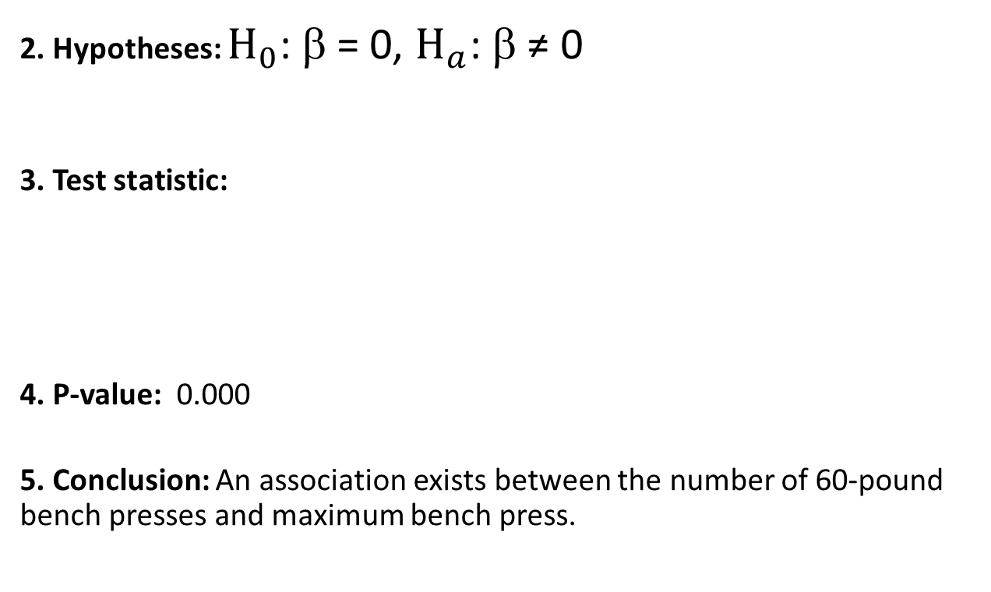
Example: 60-Pound Strength and Bench Presses
2. Hypotheses: $H_{0}$: β = 0, $H_{a}$: β ≠ 0
3. Test statistic:
4. P-value: 0.000
5. Conclusion: An association exists between the number of 60-pound bench presses and maximum bench press.

Slide 67
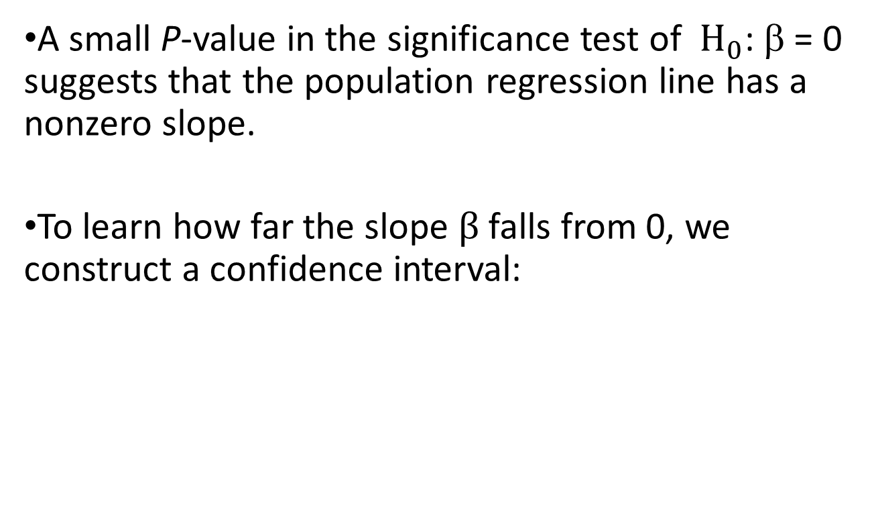
A Confidence Interval Tells Us How Precisely We Can Estimate Slope
A small P-value in the significance test of $H_{0}$: β = 0 suggests that the population regression line has a nonzero slope.
To learn how far the slope $β$ falls from 0, we construct a confidence interval:

Slide 68
Example: Estimating the Slope for Predicting Maximum Bench Press
Construct a 95% confidence interval for β.
Based on a 95% CI, we can conclude, on average, the maximum bench press increases by between 1.2 and 1.8 pounds for each additional 60-pound bench press that an athlete can do.

Slide 69
Example: Estimating the Slope for Predicting Maximum Bench Press
Let’s estimate the effect of a 10-unit increase in x:
  Since the 95% CI for β is (1.2, 1.8), the 95% CI for
  10β is (12,18).
  On the average, we infer that the maximum bench press increases by at least 12 pounds and at most 18 pounds, for an increase of 10 in the number of 60-pound bench presses.

Slide 70
Describing the Strength of the Association

Slide 71
Correlation Is a Standardized Slope
We can’t use the slope to describe the strength of the association between two variables because the slope’s numerical value depends on the units of measurement.
The correlation is a standardized version of the slope.
The correlation does not depend on units of measurement.

Slide 72
Correlation and Slope
The correlation and the slope are related in the following way:

Slide 73
Example: Predicting Strength
For the female athlete strength study:
  x: number of 60-pound bench presses
  y: maximum bench press
  x: mean = 11.0, standard deviation = 7.1
  y: mean= 79.9 lbs, standard deviation = 13.3 lbs
Regression equation:

Slide 74
Example: Predicting Strength
The variables have a strong, positive association.

Slide 75
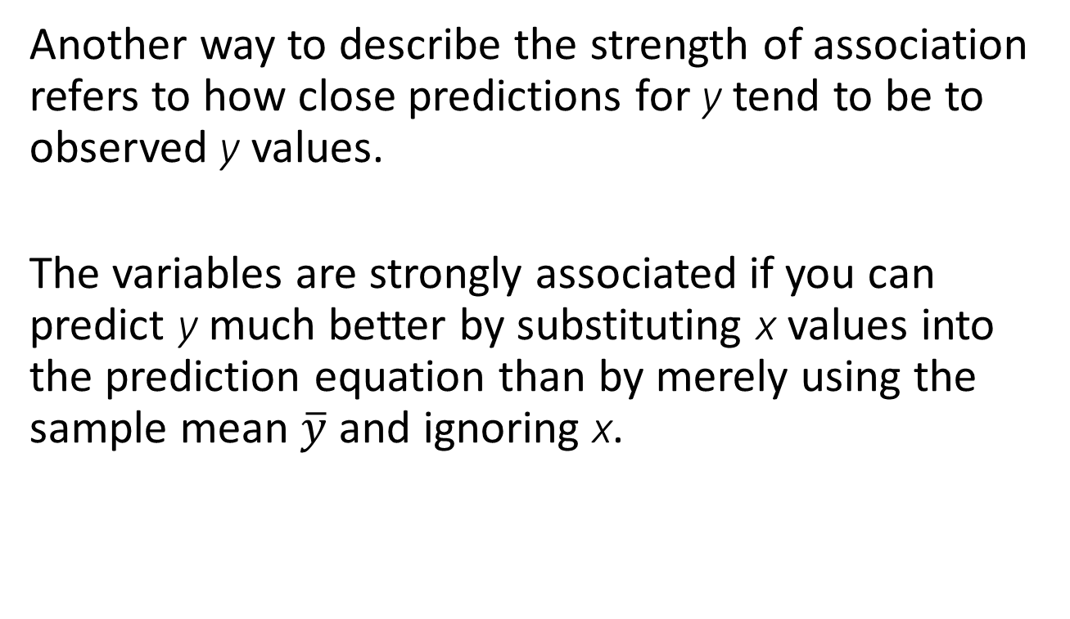
The Squared Correlation
Another way to describe the strength of association refers to how close predictions for y tend to be to observed y values.
The variables are strongly associated if you can predict y much better by substituting x values into the prediction equation than by merely using the sample mean $\overline{y}$ and ignoring x.

Slide 76
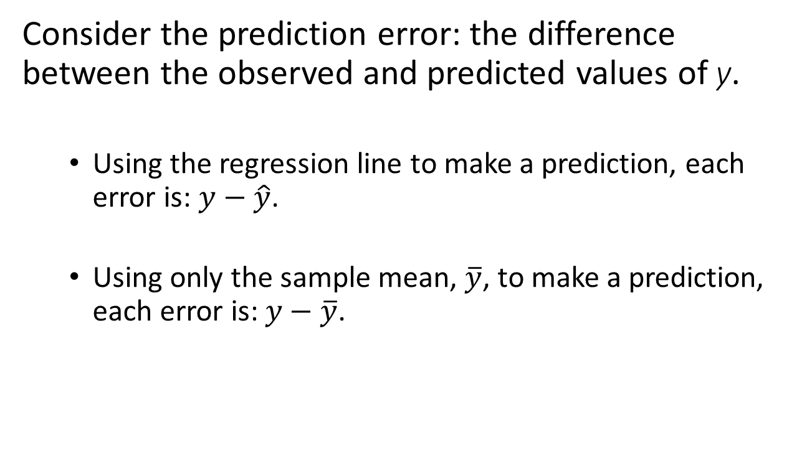
The Squared Correlation
Consider the prediction error: the difference between the observed and predicted values of y.
  Using the regression line to make a prediction, each error is: $y−\hat{y}$.
  Using only the sample mean, $\overline{y}$, to make a prediction, each error is: $y−\overline{y}$.

Slide 77
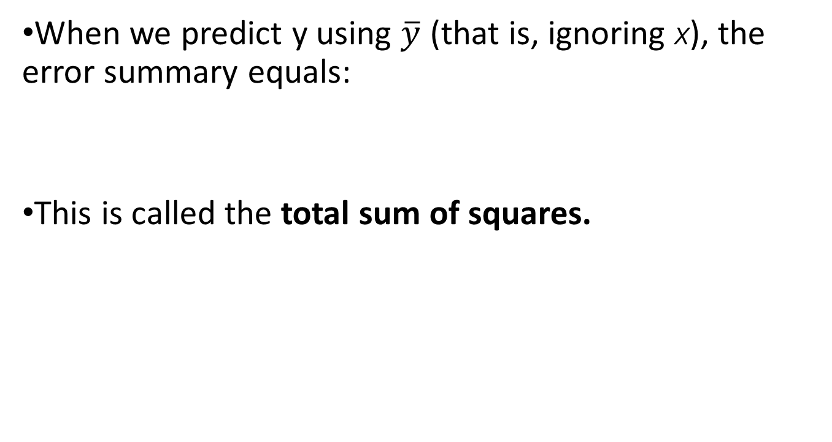
The Squared Correlation
When we predict y using $\overline{y}$ (that is, ignoring x), the error summary equals:
This is called the total sum of squares.

Slide 78
The Squared Correlation
When we predict y using x with the regression equation, the error summary is:
This is called the residual sum of squares.

Slide 79
The Squared Correlation
When a strong linear association exists, the regression equation predictions tend to be much better than the predictions using ӯ.
We measure the proportional reduction in error and call it, r² .

Slide 80
The Squared Correlation
We use the notation r² for this measure because it equals the square of the correlation r.

Slide 81
Example: Strength Study
For the female athlete strength study:
  x: number of 60-pound bench presses
  y: maximum bench press
  The correlation value was found to be r = 0.80.
We can calculate r² from r: (0.80)² = 0.64.
For predicting maximum bench press, the regression equation has 64% less error than ӯ has.

Slide 82
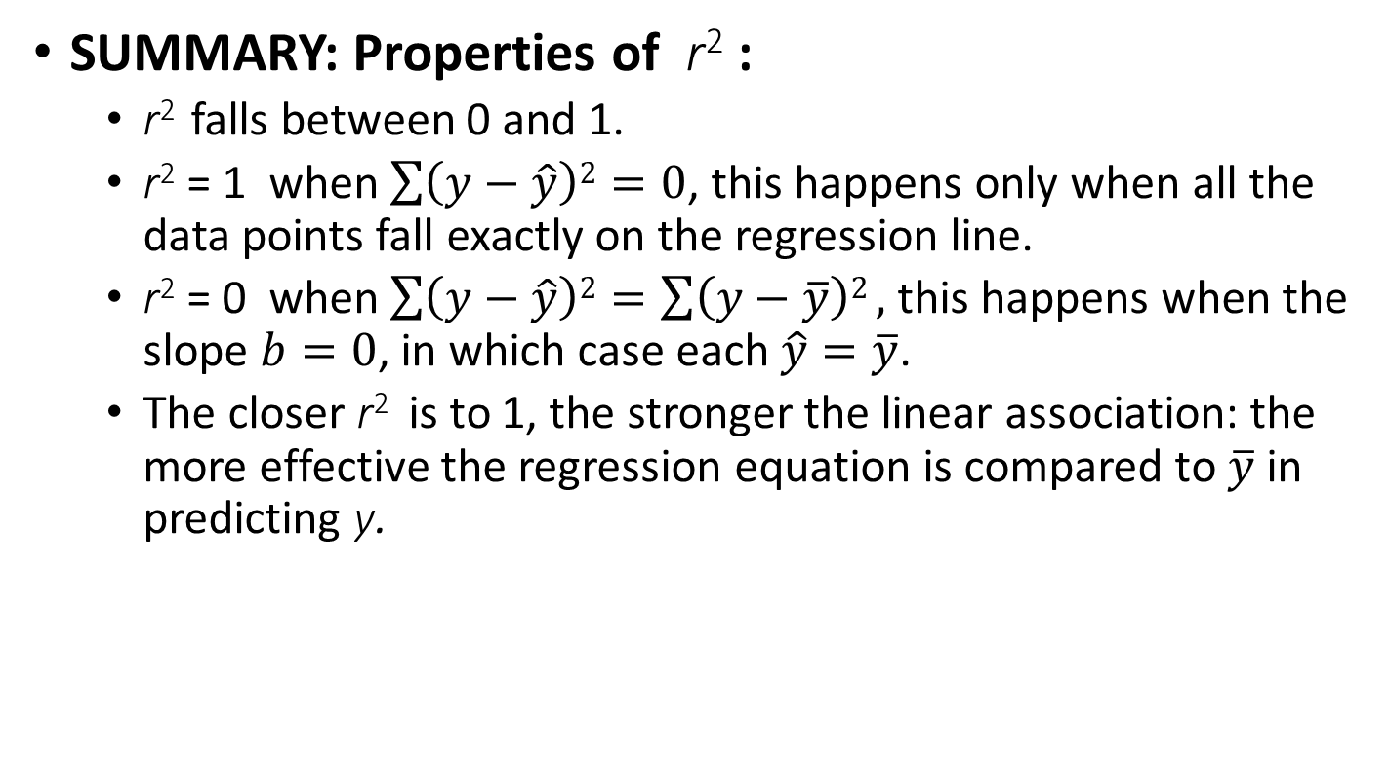
The Squared Correlation
SUMMARY: Properties of r² :
  r² falls between 0 and 1.
  r² = 1 when $\sum{\left(y−\hat{y}\right)2}=0$, this happens only when all the data points fall exactly on the regression line.
  r² = 0 when $\sum{\left(y−\hat{y}\right)2}=\sum{\left(y−\overline{y}\right)2},$ this happens when the slope $b=0$, in which case each $\hat{y}=\overline{y}$.
  The closer r² is to 1, the stronger the linear association: the more effective the regression equation is compared to $\overline{y}$ in predicting y.

Slide 83
SUMMARY: Correlation r and Its Square r²
Both r and r² describe the strength of association.
‘r’ falls between –1 and +1.
  It represents by how many standard deviations y is predicted to change when x changes by one standard deviation.
‘r² ’ falls between 0 and 1.
  It summarizes the reduction in the prediction error when using the regression equation.

Slide 84
How the Data Vary Around the Regression Line

Slide 85
Histogram of Residuals
A histogram of residuals is a good way of detecting unusual observations.
A histogram is also a good way of checking the assumption that the conditional distribution of y at each x value is normal.
Look for an approximately bell-shaped histogram.

Slide 86
Histogram of Residuals
Suppose the histogram is not bell-shaped:
  The distribution of the residuals is not normal.
  However….
  Two-sided inferences about the slope parameter still work quite well.
  The t-inferences are robust.

Slide 87
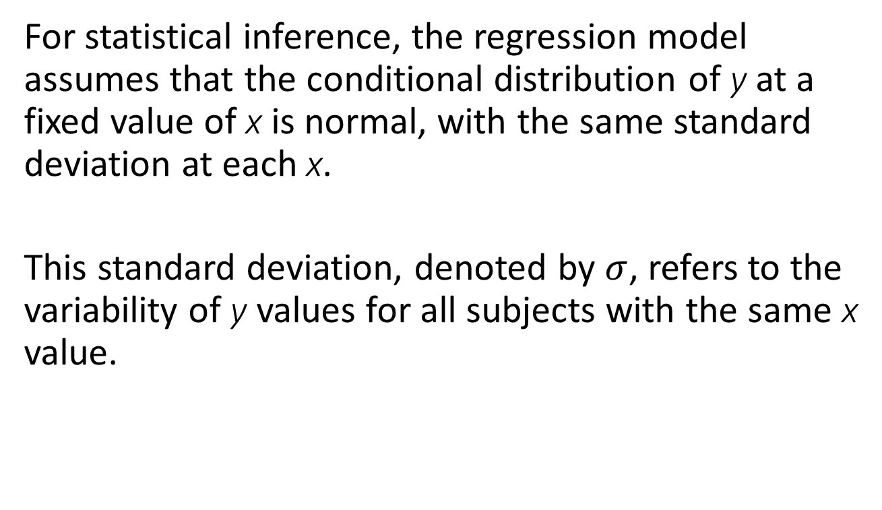
The Residual Standard Deviation
For statistical inference, the regression model assumes that the conditional distribution of y at a fixed value of x is normal, with the same standard deviation at each x.
This standard deviation, denoted by $σ$, refers to the variability of y values for all subjects with the same x value.

Slide 88
The Residual Standard Deviation
The estimate of σ, obtained from the data, is called the residual standard deviation:

Slide 89
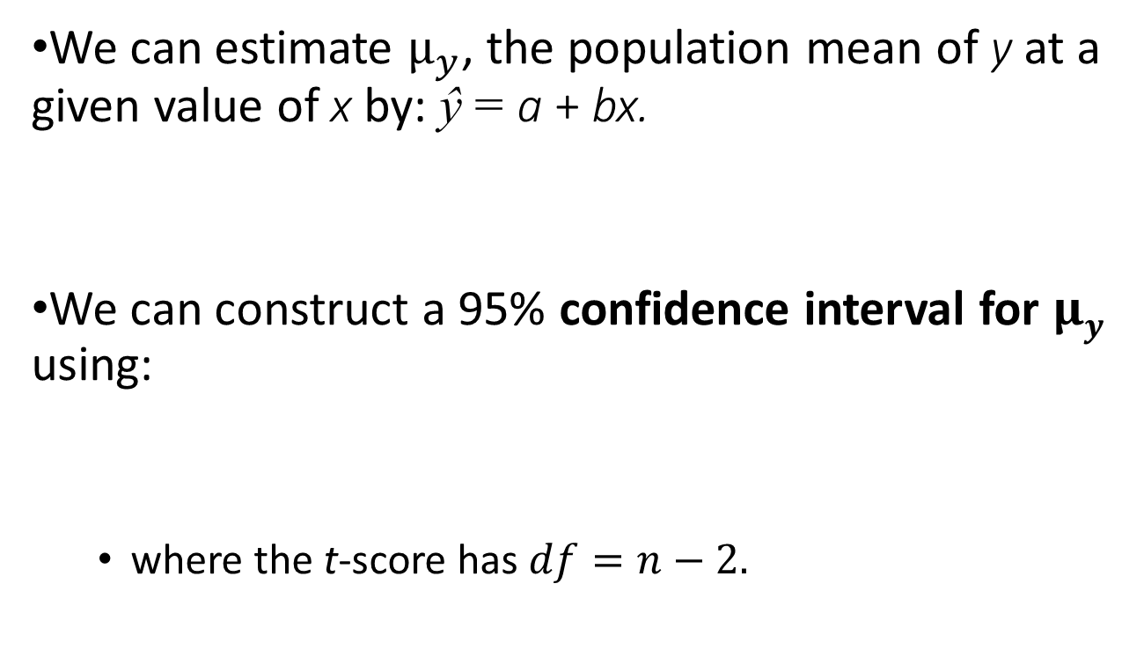
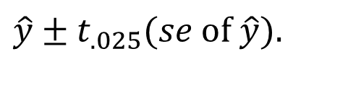
Confidence Interval for
We can estimate $μ_{y}$, the population mean of y at a given value of x by: ŷ = a + bx.
We can construct a 95% confidence interval for $μy$ using:
  where the t-score has $df=n−2.$
$$\hat{y}±t_{.025}(se \text{of} \hat{y}).$$

Slide 90
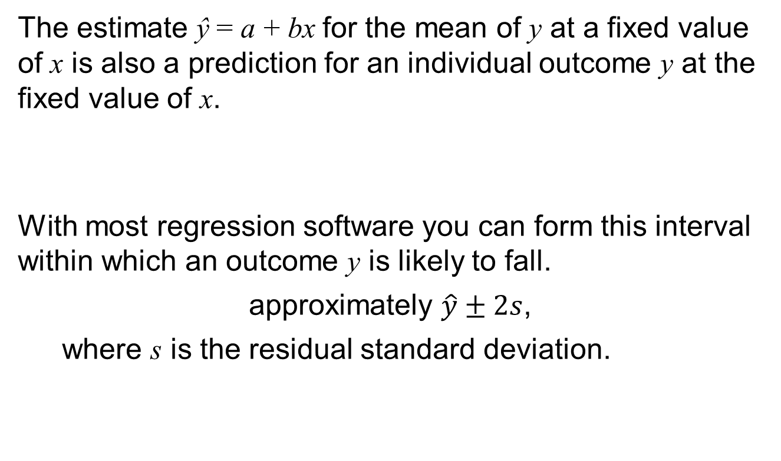
Prediction Interval for y
The estimate ŷ = a + bx for the mean of y at a fixed value of x is also a prediction for an individual outcome y at the fixed value of x.
With most regression software you can form this interval within which an outcome y is likely to fall.
  approximately $\hat{y}±2s$,
  where s is the residual standard deviation.

Slide 91
Prediction Interval for y vs. Confidence Interval for
The prediction interval for y is an inference about where individual observations fall.
  Use a prediction interval for y if you want to predict where a single observation on y will fall for a particular x value.

Slide 92
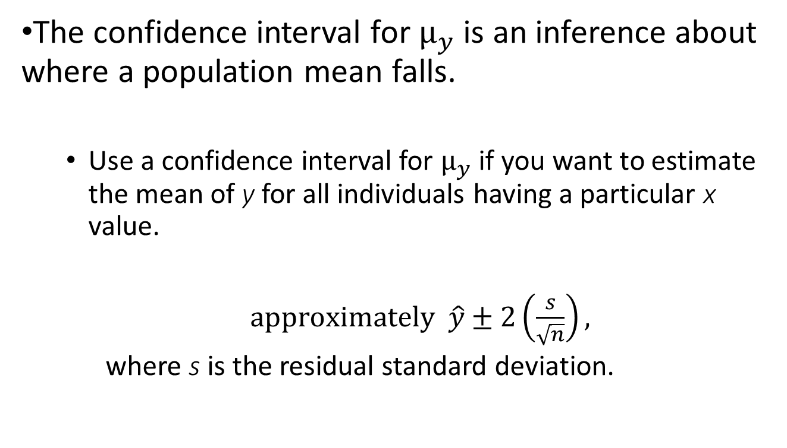
Prediction Interval for y vs. Confidence Interval for
The confidence interval for $μ_{y}$ is an inference about where a population mean falls.
  Use a confidence interval for $μ_{y}$ if you want to estimate the mean of y for all individuals having a particular x value.
  $approximately \hat{y}±2\left(\frac{s}{\sqrt{n}}\right),$
  where s is the residual standard deviation.

Slide 93
Prediction Interval for y vs. Confidence Interval for
Note that the prediction interval is wider than the confidence interval - you can estimate a population mean more precisely than you can predict a single observation.
Caution: In order for these intervals to be valid, the true relationship must be close to linear with about the same variability of y values at each fixed x value.

Slide 94
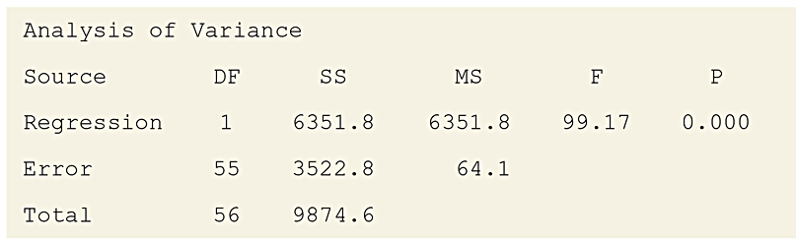
The Analysis of Variance (ANOVA) Table Summarizes Variability
Software reports the sums of squares (SS) used in estimating standard deviations and variances (their squares) in an analysis of variance (ANOVA) table.
Table 12.6 Analysis of Variance (ANOVA) Table for the Strength Study
$$\text{regressions} \text{SS} =\sum{{\left(\hat{y}−\bar{y}\right)}^{2}\text{, }\text{and} \text{it} \text{equals}} \sum{{\left(y−\bar{y}\right)}^{2}}−\sum{{\left(y−\hat{y}\right)}^{2}}.$$

Slide 95
The Analysis of Variance (ANOVA) Table Summarizes Variability
These three types of sums of squares are connected by the basic ANOVA identity
Total SS = Regression SS + Residual SS.
Regression SS + Residual SS =
6351.8 + 3522.8 = 9874.6, the Total SS.

Slide 96
Mean Square and Mean Square Error
The ratio of a sum of squares to its df value is called a mean square. It is listed in the ANOVA table under the heading MS.
The ratio of residual sum of squares = 3522.8 to its df = 55 gives 64.1. This ratio is the mean square error, often abbreviated as MS error or as MSE.
The square root of MSE, s, (the residual standard deviation) is a typical size of a residual (that is, a prediction error).

Slide 97
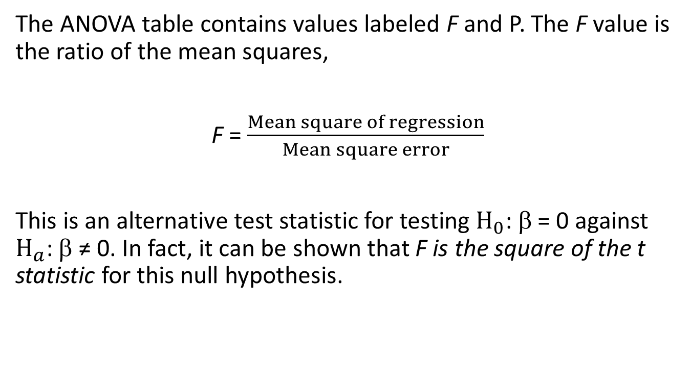
The ANOVA F Statistic Also Tests for an Association
The ANOVA table contains values labeled F and P. The F value is the ratio of the mean squares,
F = $\frac{Mean square of regression}{Mean square error}$
This is an alternative test statistic for testing $H_{0}$: β = 0 against $H_{a}$: β ≠ 0. In fact, it can be shown that F is the square of the t statistic for this null hypothesis.

Slide 98
Exponential Regression: A Model for Nonlinearity

Slide 99
Nonlinear Regression Models
If a scatterplot indicates substantial curvature in a relationship, then equations that provide curvature are needed.
  Occasionally a scatterplot has a parabolic appearance: as x increases, y increases then it goes back down.
  More often, y tends to continually increase or continually decrease but the trend shows curvature.

Slide 100
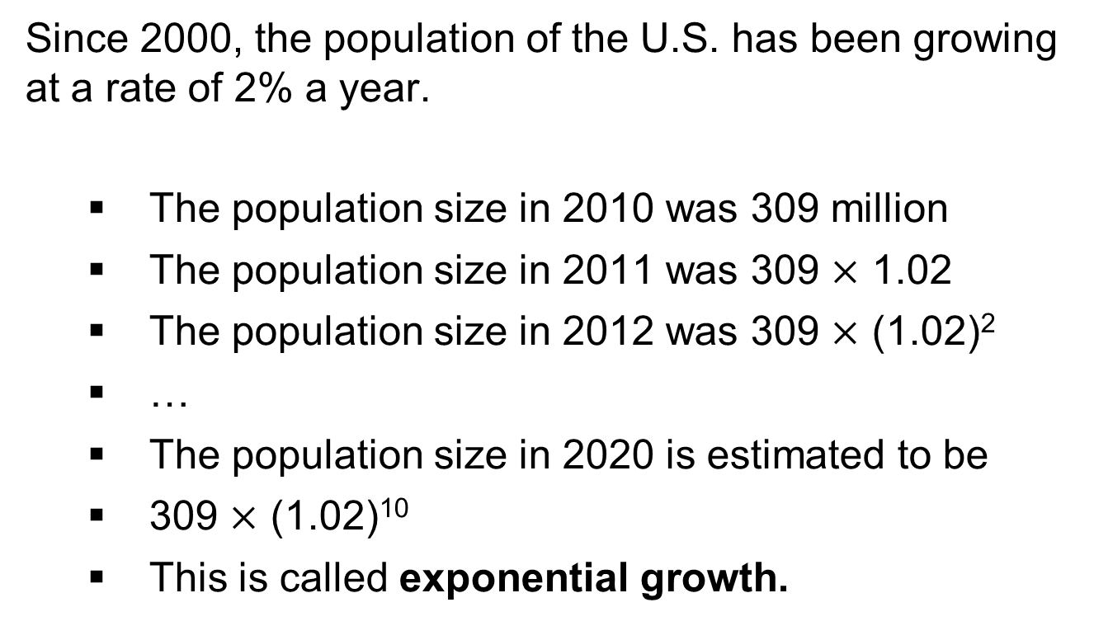
Example: Exponential Growth in Population Size
Since 2000, the population of the U.S. has been growing at a rate of 2% a year.
  The population size in 2010 was 309 million
  The population size in 2011 was 309 $×$ 1.02
  The population size in 2012 was 309 $×$ (1.02)²
  …
  The population size in 2020 is estimated to be
  309 $×$ (1.02)¹⁰
  This is called exponential growth.

Slide 101
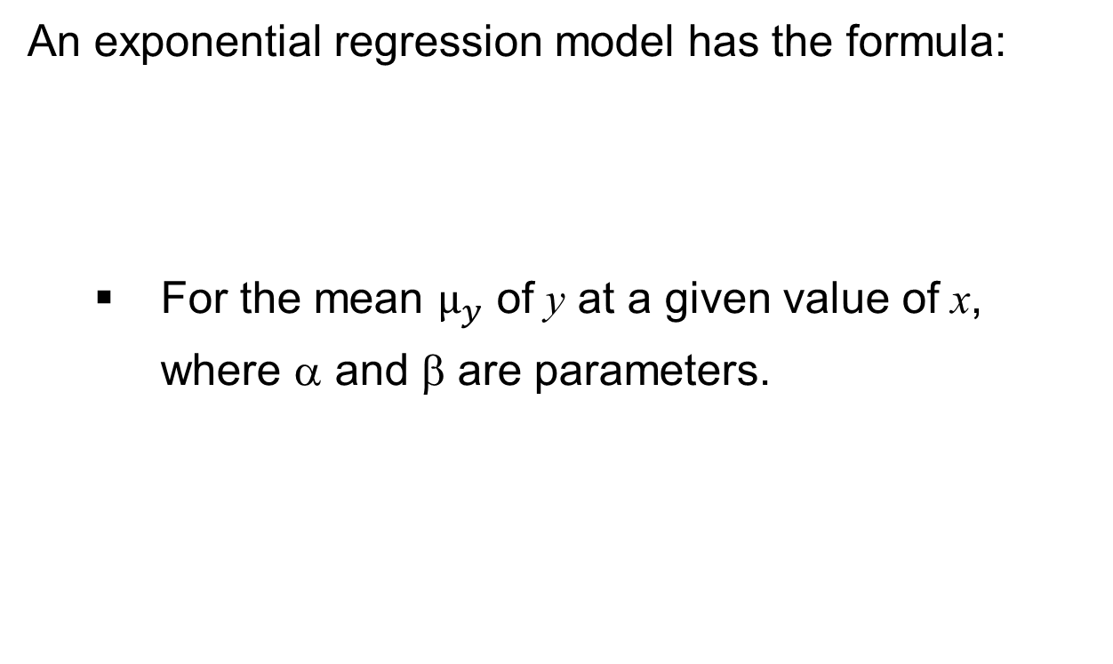
Exponential Regression Model
An exponential regression model has the formula:
  For the mean $μ_{y}$ of y at a given value of x,
  where α and β are parameters.

Slide 102
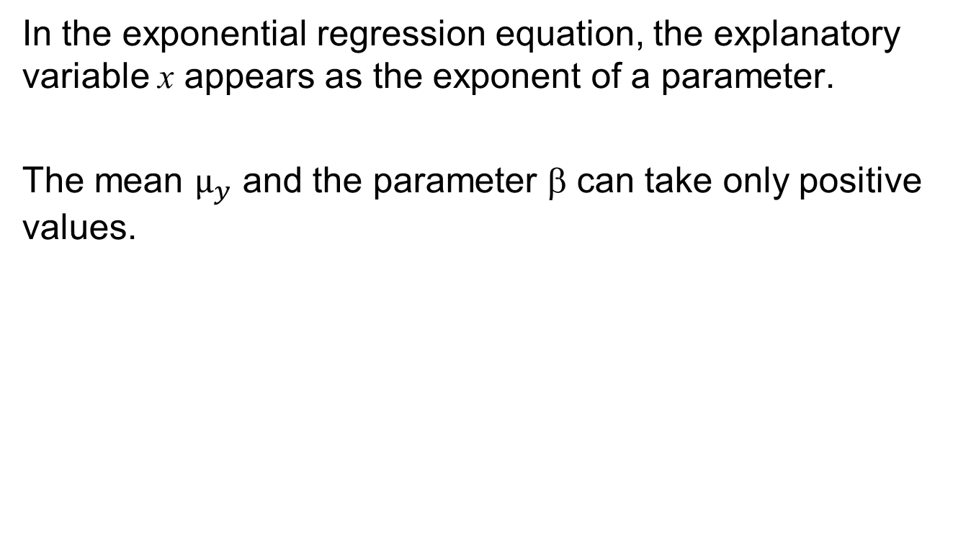
Exponential Regression Model
In the exponential regression equation, the explanatory variable x appears as the exponent of a parameter.
The mean $μ_{y}$ and the parameter β can take only positive values.

Slide 103


Exponential Regression Model
As x increases, the mean $μy$ increases when $β>1.$
It continually decreases when $0<β<1.$
Figure 12.11 The Exponential Regression Curve for . Question: Why does $μy$ decrease if $β=0.5$, even though $β>0$?

Slide 104
Exponential Regression Model
For exponential regression, the logarithm of the mean is
a linear function of x.
When the exponential regression model holds, a plot of
the log of the y values versus x should show an
approximate straight-line relation with x.

Slide 105

Example: Moore’s Law
Table 12.7 Number of Components Per Square Inch on Microchips Produced Between 1959 and 1965

Slide 106

Example: Moore’s Law
Figure 12.12 Plot of Number of Components on a Microchip Over the Years.
The first graph shows the data from Table 12.7 for the years 1959 to 1965 and overlays
the prediction curve from an exponential regression model. The second graph shows the
same data but now displays what would happen if the exponential trend would continue
for 10 years after 1965, to 1975. The circles for 1970 and 1975 shown in the plot are
predictions beyond the observed range of the data.

Slide 107

Example: Moore’s Law
Let x denote the years since the invention of the microchip in 1959 (x = 0 for 1959, x = 3 for 1962, x = 4 for 1964, etc.) and let y be the number of components on a chip x years after the invention of the first chip.
Using software to fit the exponential regression model for the mean of y, we obtain
ŷ = 0.973 $×$2.006^{x}.

Slide 108
Interpreting Exponential Regression Models
In the exponential regression model,
  the parameter α represents the mean value of y when x = 0;
  the parameter β represents the multiplicative effect on the mean of y for a one-unit increase in x.

Slide 109

Example: Moore’s Law
In this model: ŷ = 0.973 $×$ 2.006^{x}
what is the predicted number of components in 1975, x = 16 years after the invention of the first chip and the year for which Moore predicted 65,000 components?
Ten years later, in 1975 and x = 16 years after the invention of the first chip, we obtain ŷ = 0.973 $×$ 2.006¹⁶
= 66,897 as a prediction for the mean number of components that would fit on a microchip.

